Slide 1
Mediator
A Behavioral Pattern

Slide 2
Problem:
Simple enough right?
Object
Object
Object

Slide 3
Problem:
How about now?
Object
Object
Object
Object
Object

Slide 4
What does it do?
Encapsulates object-to-object communication.
Handles the many-to-many relationship
Keeps objects from knowing about each other
Keeps things modular and simple
Allows for the addition and subtraction of classes at any time in the development phase.
Keeps the code pretty.

Slide 5
Solution:
Better!
Object
Object
Object
Mediator
Object
Object
Now you can insert as many objects as you want without fear of breaking the code!
Note the connections now have direction.

Slide 6
When to use:
Reusing an object over and over
When multiple objects are interacting in multiple ways with several different objects
When centralized control is desired
When simple objects need to communicate in complex ways

Slide 7
Key Parts
There are two main parts to a Mediator Pattern:
Colleagues – The object(s) that are interacting with one another.
Mediator – The object that will facilitate said interactions.
There is only one mediator, but there are always two or more colleagues.

Slide 8
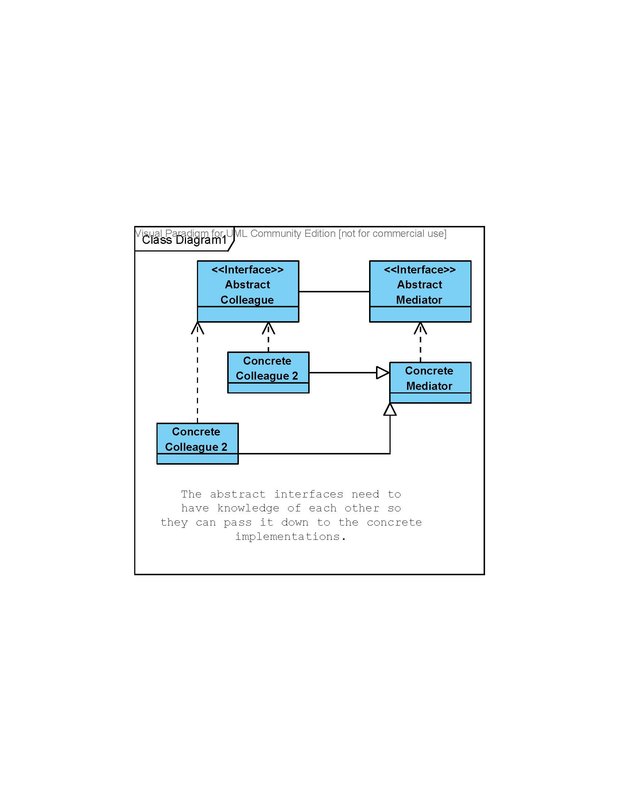

Slide 9
Pros and Cons
Pros:
Facilitates decoupling, this allows for reuse
Keeps communication simple, allowing for easier maintenance.
Limits sub-classing and specialization, also allowing for reuse.
Simplifies overall architecture by taking a many-to-many relationship to a one-to-many relationship.

Slide 10
Pros and Cons
Cons:
As complexity is reduced in the colleagues, it increases in the mediator
It’s difficult to keep the mediator from being an all controlling class
It’s meant to facilitate, not control the data/logic flow.
On the flip side, limiting sub-classing and specialization can limit functionality of the project.

Slide 11
Similar, but Different
The mediator pattern is similar to the observer class, but it facilitates communication between existing objects in their current state, it does not create observers.
The mediator patter is also similar to the façade pattern, however there is a two way communication between the mediator class and the colleague classes.

Slide 12
Code Example
// The mediator class
class Mediator {
private int Number;
public void store( int num )
{
// no room for another producer
while (full == true)
{
wait();
}
// store the number
Number = num;
// notify the consumer @full
notifyAll();
}
public int retrieve()
{
// no message to retrieve
while (full == false)
{
wait();
}
full = false;
// notify the producer @empty
notifyAll();
// return the number
return number;
}
}// end class mediator

Slide 13
Producer Class
class Producer extends Thread
{
// Only contains a Mediator object, not a consumer object
private Mediator med;
private int number;
// constructor
public Producer( Mediator m )
{
med = m;
// a unique producer each time
number = number++;
}
// produce
public void driver()
{
while (true)
{
med.storeMessage( number );
System.out.print( number + “\n” );
}
}
}// end class producer

Slide 14
Consumer Class
class Consumer extends Thread
{
// only contains a mediator object
private Mediator med;
private int number;
//constructor
public Consumer( Mediator m )
{
med = m;
number = number++;
}
//consume
public void driver()
{
while (true)
{
System.out.println(number);
}
}
}//end class consumer

Slide 15
Code Example
The two colleagues only communicate with the mediator.
The mediator only controls the communication pathways, NOT the actual logic or control.
The two classes only need to know what they should do, they do not need a sizeable knowledge of the program as a whole (or any other class but the mediator).

